Slide 1



Hi-Ball Scientific Payload Arizona Nasa Space Grant Consortium April 18, 2009 Arizona State Univerity
Team:
Jessica Avitia
Mary Begay
Daniella Eriksson
Bryce Fox
Mentors:
Jack Crabtree
Dr. Ronald Madler
ASGC Symposium

Slide 2

Presentation Summary
Purpose
Components
First Flight / Testing
Future Goals

Slide 3
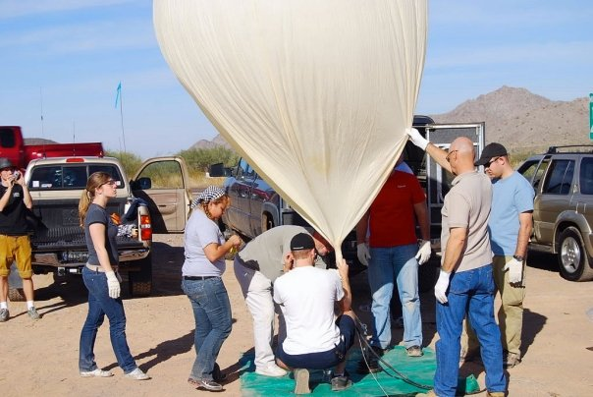
Purpose
To provide tracking support for the Embry-Riddle ballooning community.
The main purpose of the Hi-Ball payload is to track longitude, latitude, altitude and speed of the scientific balloon.
The collection of this data is a way to predict future missions by providing a database of information.

Slide 4
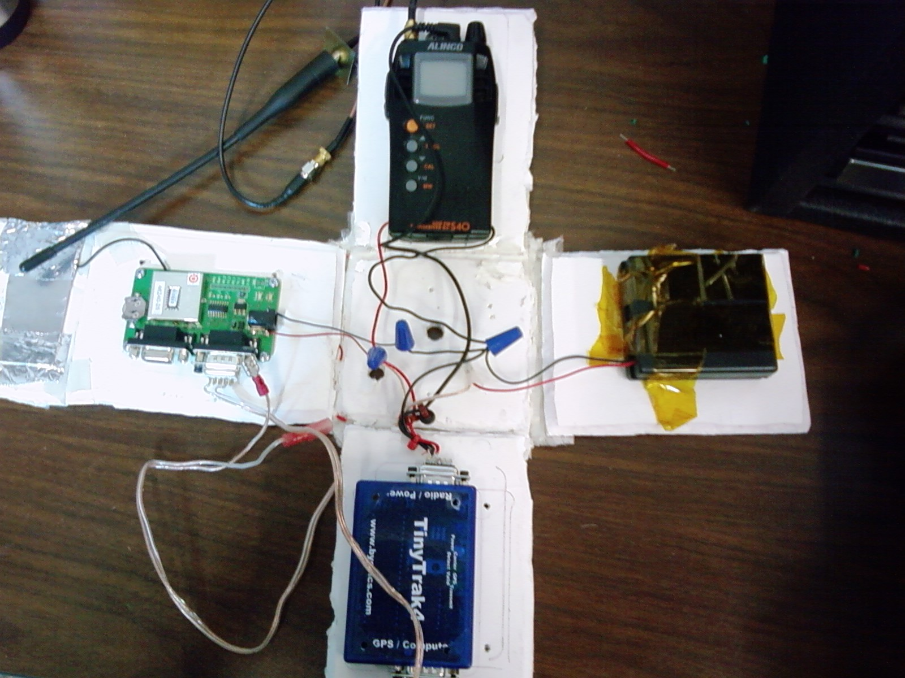
Payload Components
Alinco Transceiver
Radio
Trimble GPS
46240-25
Battery Pack
Tiny Trak4

Slide 5
Components
Tiny Trak4 (Modem)
Alinco UHF FM Transceiver S40
Transmits and receives at 445.925 MHz
Trimble GPS -46240-25
Battery Pack
Four AA batteries

Slide 6
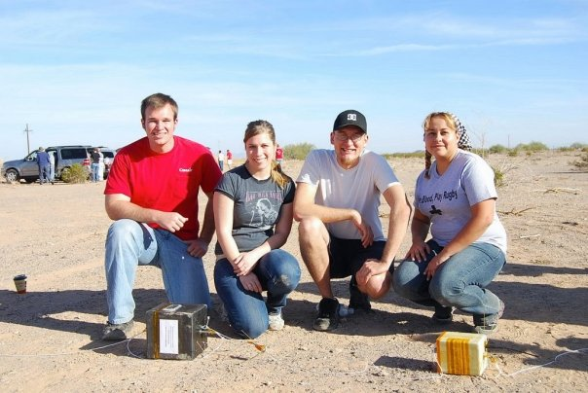
Flight / Testing
First launch was on November 27, 2008 in Gila Bend, AZ recovered South of Phoenix
GPS Failed during flight
Tested GPS in cold chamber
GPS stands temperature below 63 degrees Celsius
Conclusion
Ports were switch on GPS board during connection

Slide 7
Future Goals
Add different components to the payload
Accelerometers
Camera
Physics and/or other scientific experiments
Test new structures for thermal capacities
Thickness
Materials
Insulation

Slide 8

Acknowledgements
Dr. Ronald Madler
Jack Crabtree
Dr. John Nafziger
Chris Smith
Arizona NASA Space Grant and partners

